Slide 1



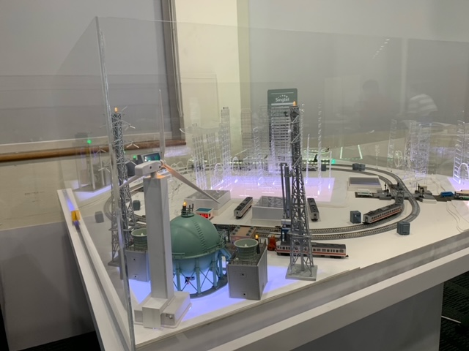
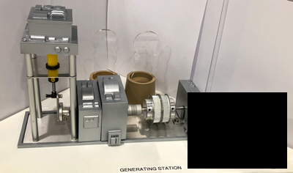
2.7 Create the fake generator turn off cmd to cut off the power supply
Technical PC
2.2 MS-Word document with embedded macrodocument from phishing email
2.1 Blackout Atk on cmd
IP: 192.168.10.251
2.4 Send atk active cmd
orchestrator PC
Attacker
(Raspberry PI)
1.1 False data injection Atk on cmd
IP: 192.168.10.90
2.3 Scan the network and fetch PLC information.
IP: 192.168.10.91
1.2 Reverse Runway light control and feedback signal data.
2.5 Block the network, feed fake data to HMI, turn off all the output of PLC
3.1 Stealthy Substation Attack
SCADA PC
OT Railway module
Modbus TCP/feedback cmd
IP: 192.168.10.21
3.2 Create unstable load feed back cmd from substation module
Generator 3D Module
Generator Controller (Raspberry PI)
Serial COM
Power
IP: 192.168.10.244
PLC IP: 192.168.10.71/72/73

Slide 2
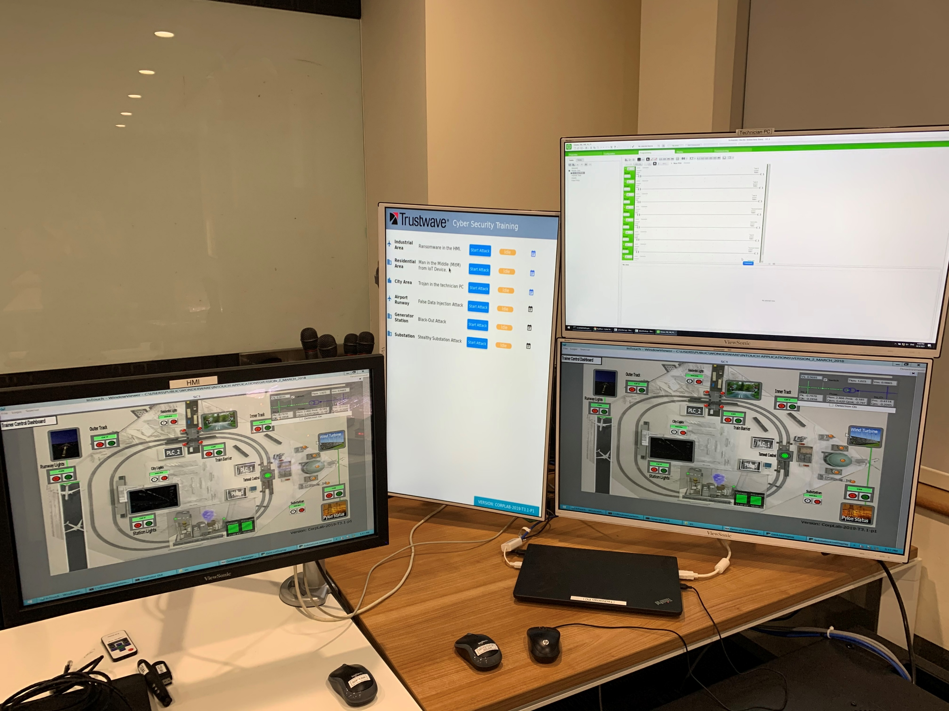
Technical PC
Orchestrator PC
SCADA HMI PC

Slide 3
